Slide 1
SQL PROJECT ON PIZZA SALES
BY TEJASHWINI S M

Slide 2
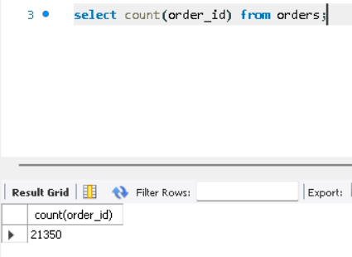
Q1. Retrieve the total number of orders placed.

Slide 3
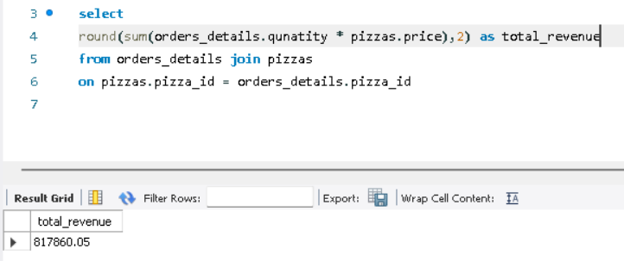
Q2. Calculate the total revenue generated from pizza sales.

Slide 4
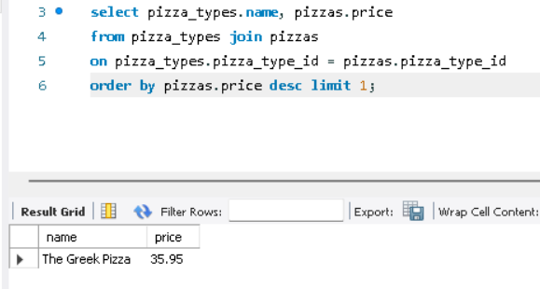
Q3. Identify the highest-priced pizza.

Slide 5
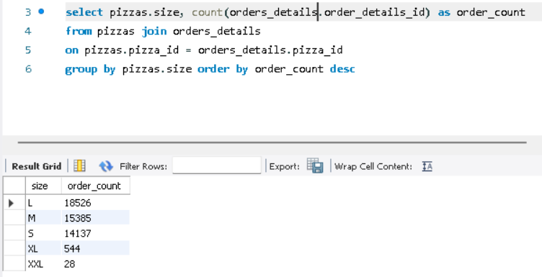
Q4. Identify the most common pizza size ordered.

Slide 6
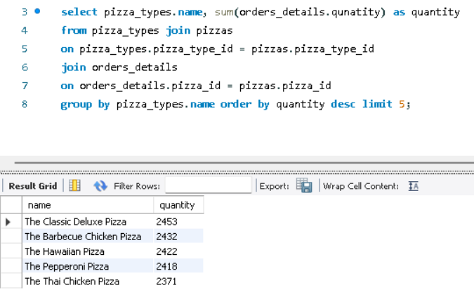
Q5. List the top 5 most ordered pizza types along with their quantities.

Slide 7
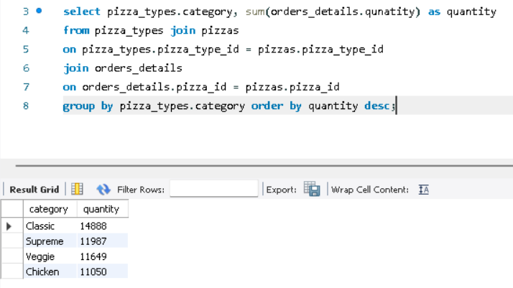
Q6. Find the total quantity of each pizza category ordered.

Slide 8
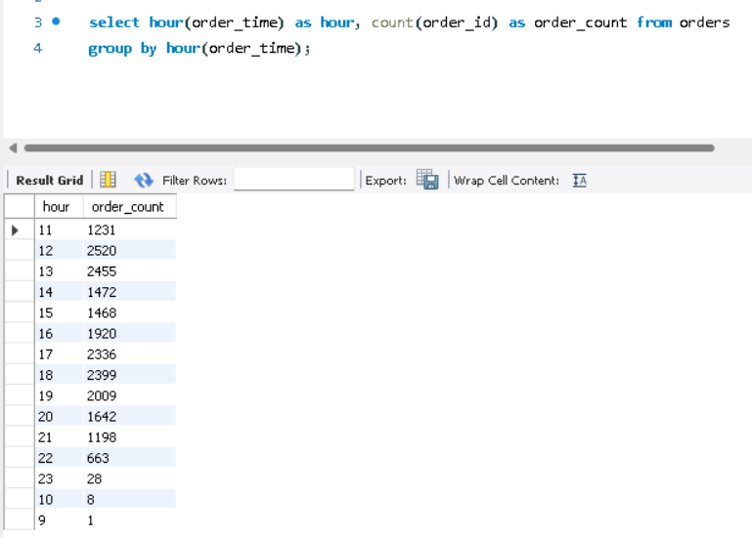
Q7. Determine the distribution of orders by hour of the day.

Slide 9
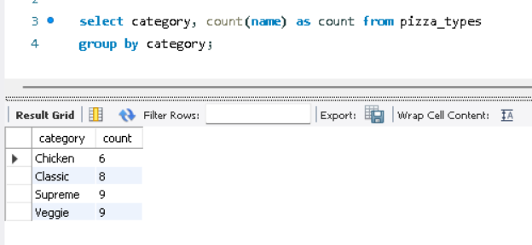
Q8. Find the category-wise distribution of pizzas.

Slide 10
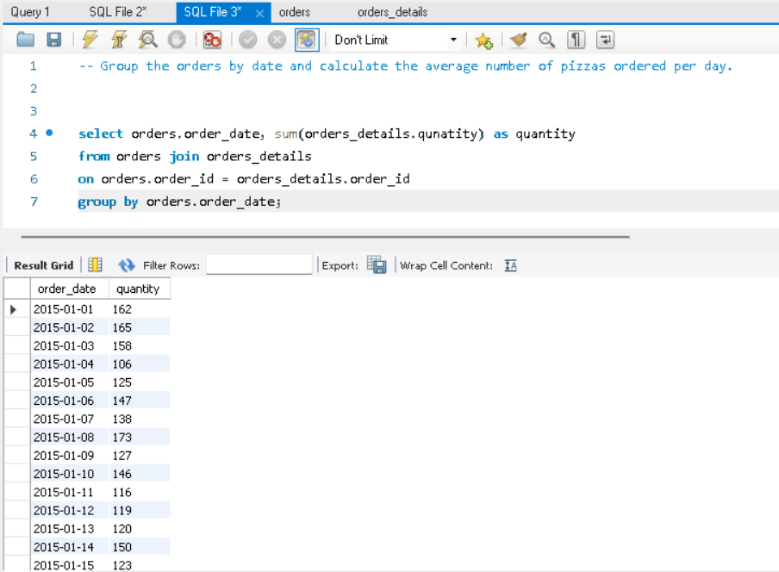
Q9. Group the orders by date and calculate the average number of pizzas ordered per day.

Slide 11
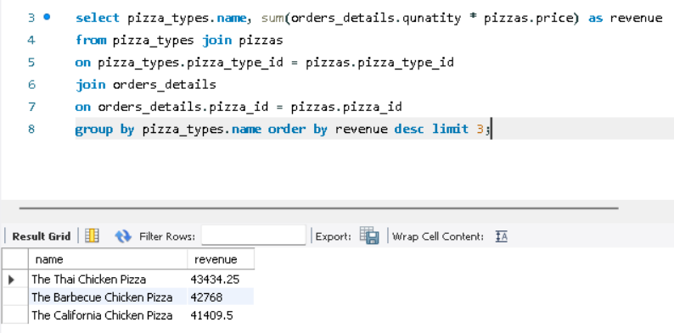
Q10. Determine the top 3 most ordered pizza types based on revenue.

Slide 12
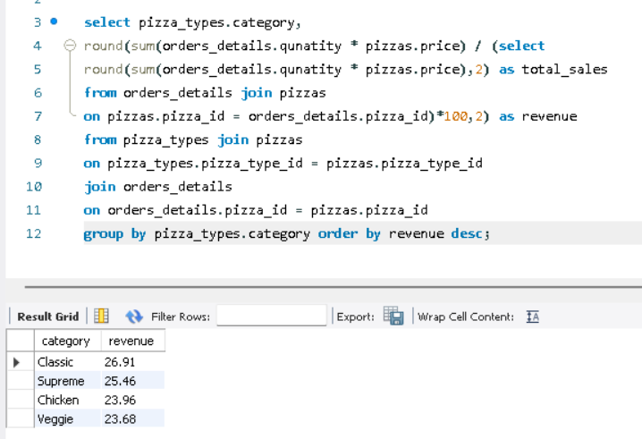
Q11. Calculate the percentage contribution of each pizza type to total revenue.

Slide 13
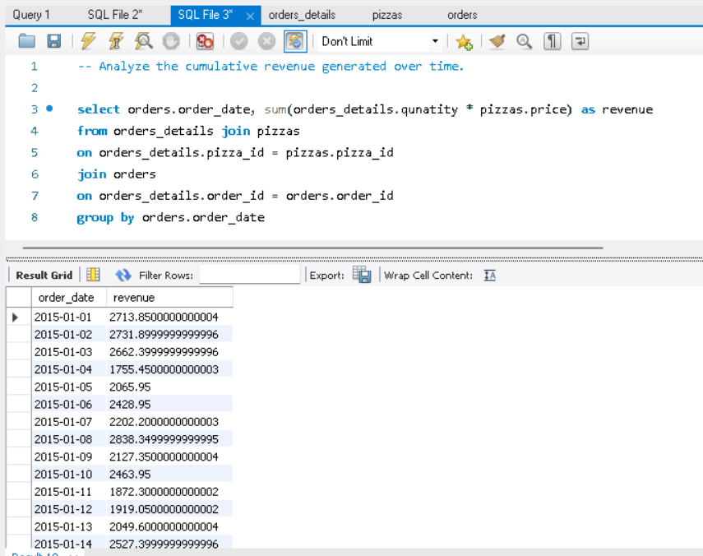
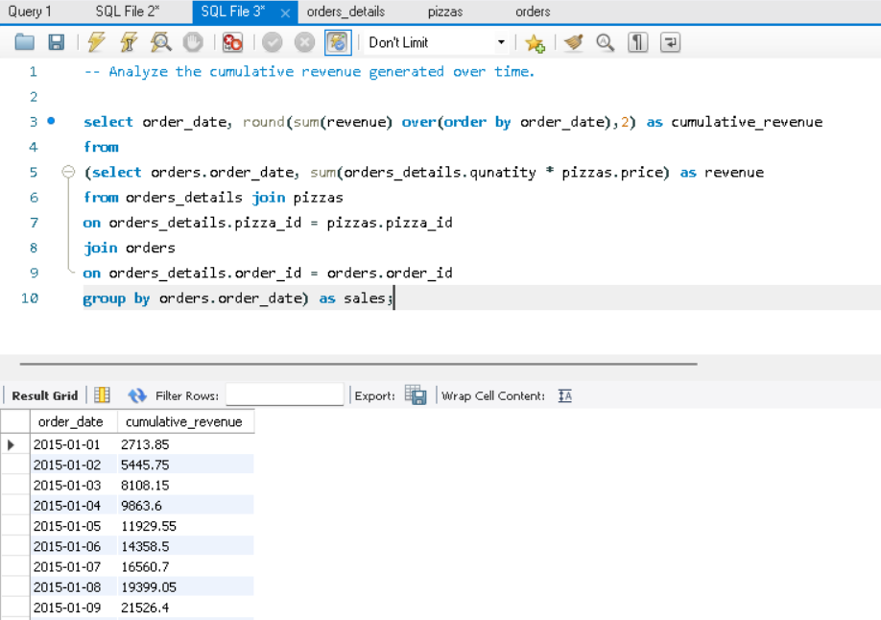
Q12. Analyze the cumulative revenue generated over time.

Slide 14
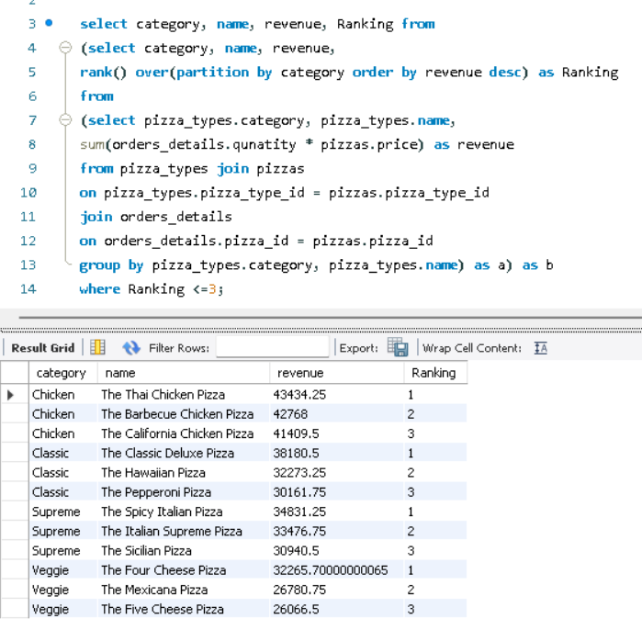
Q13. Determine the top 3 most ordered pizza
types based on revenue for each pizza category.

